Slide 1
MFRE Summer Series: Python Programming 1 Harry Izatt
2023/24 Summer Program

Slide 2
Part 0: Introduction and Itinerary
2023/24 Summer Program

Slide 3

Welcome to MFRE!

Slide 4

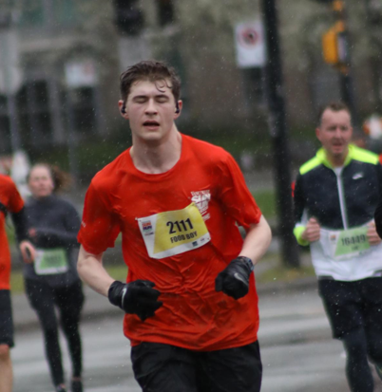
Introduction: Who am I?
Data Analytics Coordinator
Develop and update programming curriculum
Teach workshops in Python, R, Excel, SQL, etc.
UBC alum, but not MFRE
BA, MA in Economics at Vancouver School of Economics
Focus on applied machine learning, econometrics, data analysis, history
In my spare time:
Reading
Running
Board games

Slide 5
Introduction: Who are you?
Tell me a bit about yourselves!
Go to following website, input the code
menti.com
61 22 81 3

Slide 6
Why are we learning to program?
Programming and quantitative skills – vital part of MFRE Data Plan
Core competency used in many fields
MFRE economic analysis
Policy analysis
Industry needs: data analysis
Any analytics job involves:
Reshaping data
Cleaning data
Visualizing data
Modelling data
Learn to learn
Picking up (n+1)th programming language easier than the nth

Slide 7
Summer Session Programming Roadmap
1. DataCamp Courses (done!)
R, Python
2. Assessment Quiz (done!)
3. Python Workshops
Python 1: Data Type Review and Lists
Python 2: Data Cleaning with `pandas`
4. R Workshops
R 1: Data Types, Control Flow, Best Practices
R 2: Data Cleaning with `dplyr`, Visualization with `ggplot2`
5. Applied Data Workshops
R Application
Python Application

Slide 8
Python Workshops
Python Workshop 1: Today
Basics of Data Types and Structures
1. Review strings, floats, integers, Booleans
2. Working with lists
Python Workshop 2: Tomorrow
Data import, cleaning, and exploratory analysis with `pandas`

Slide 9
Python Workshop 1 Itinerary
1. Data types and structures
1.1 Strings, Floats, Integers, Booleans
1.2 Lists
2. List Data Type Exercises
2.1 Sorting lists
2.2 Accessing list items
2.3 Appending to lists
2.4 Removing from lists
2.5 Mapping functions to lists
2.6 Filtering lists
2.7 Compound filters
2.8 Comparison between lists
2.9 Capstone Exercise

Slide 10
Part 1: Data Types
2023/24 Summer Program

Slide 11
Introduction to Python
What is Python?
An open source programming language, known for simplicity and readability. Widely used across many applications, from data science to applications
What is it used for?
Data science and visualization
Machine Learning, Artificial Intelligence
Scripting and automation
Scientific computing
Do we use it in MFRE?
YES
#2 programming tool for data work in MFRE courses
R is primary for econometrics; Python more for general data science

Slide 12
1.1 Simple Data Types
1. String
Represent textual data; enclosed with quotes (‘single’ or “double”)
E.g.
‘Happiness’
“Misery”
Can be “indexed” to access specific elements
Feeling = “Happiness”
Feeling[0]
Returns “H”, the first letter
Feeling[1]
Returns “a”, the second letter

Slide 13
1.1 Simple Data Types
2. Float
Represent decimal numbers
E.g.
100.0
3.14
3. Integer
Represent whole numbers without decimal points
E.g.
13
2023
Both work with all general math operators:
+, -, *, /
Comparison Operators
==, >, <, >=, <=

Slide 14
1.1 Simple Data Types
4. Boolean
Represent True/False statements
Comparisons will return one or the other
E.g.
1 == 2
False
1 <= 2
True
Very important for control flow: directing Python to take specific action based on existing conditions
if variable < 2:
[do this]
else:
[do this]

Slide 15
1.2 Compound Data: Lists
5. Lists
A collection of elements of any type
Enclosed with square brackets: []
E.g.
[1, 2, 3, 4]
[“a”, “b”, “c”]
[1, 2, [1,2,3]]
Can be indexed like strings
List_1 = [1,2,3,4]
List_1[0]
Returns 1
Can be iterated through
for num in List_1:
print(num)

Slide 16
1.2 Lists in Python
Lists will be a very important data type for you from now on
You can store variables, including other lists
More advanced data types can be thought of as “lists of lists”
Pandas DataFrames
Learning to walk before we run

Slide 17
Part 2: Hands on Work A deep dive into lists
2023/24 Summer Program

Slide 18
Structure of Part 2
Part 1 was one-way
Demonstration of the basics, as revision of DataCamp courses
Part 2 is interactive
1. I introduce a new function, concept, piece of code, etc
Explanation, demonstration
These are important, core pieces of code you will use throughout MFRE
2. You’ll work on an exercise on your own computers
I can come answer questions, give assistance
Will be walking throughout
Go ahead and work with others near you

Slide 19


Colab? Jupyter Notebooks?
Code is written in development environment,
Provides a visual space to write and run code, viewing outputs
E.G. RStudio
Many include autocomplete and other features
We’re using Google Colab as our environment, hosting Jupyter Notebooks
Jupyter Notebooks (.ipynb files) allow for a mix of Markdown (text editing) and code cells (for writing, running code)
Unlike basic Python script files, easy to run code one piece at a time
Google Colab is a cloud-based environment, where we can easily upload Jupyter Notebooks (into Drive) and then run them
Free computation resources perfectly usable for our purposes

Slide 20
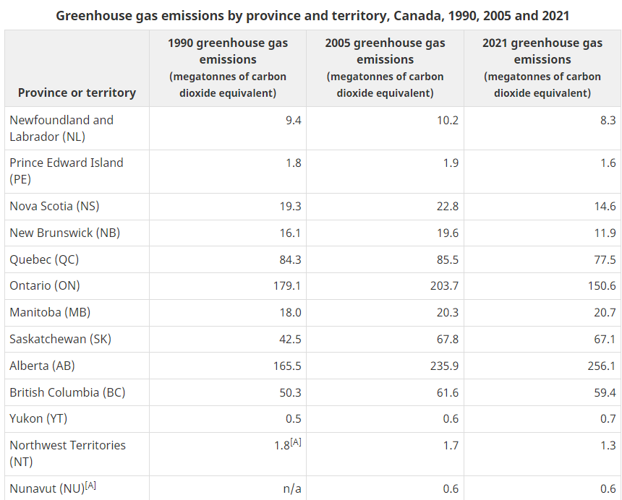
Data Introduction: Regional
Canadian carbon emissions data, by province
Posted here:
https://www.canada.ca/en/environment-climate-change/services/environmental-indicators/greenhouse-gas-emissions.html
We’re using the Regional breakdown today
Not importing as table; just assigning lists
Will do data import tomorrow!
Focus on 2005, 2021

Slide 21
Part 2 Topics
2.1 Sorting lists
`.sort()` method
2.2 Accessing list items
Indexing
2.3 Appending to lists
`.append()`
2.4 Removing from lists
`.remove()`
2.5 Mapping functions to lists
Defining functions
`map()`
2.6 Filtering lists
`if` and `else` conditionals
Value comparisons
2.7 Compound filters
Two-condition comparisons
2.8 Comparison between lists
Indexing in `range(len(list))`
2.9 Final Exercise
Basic data visualization

Slide 22
Heading over to Python…
2023/24 Summer Program

Slide 23
Python Workshop 1 Conclusion
2023/24 Summer Program

Slide 24
What we learned
Basic Python data types
`for` loops
Conditional statements
Logical comparison
Defining functions
Basic visualization

Slide 25

Next Workshop:
Working with community packages
Pandas
Data import
Data cleaning
Exploratory analysis

Slide 26
Thanks for coming!
2023/24 Summer Program

